Slide 1
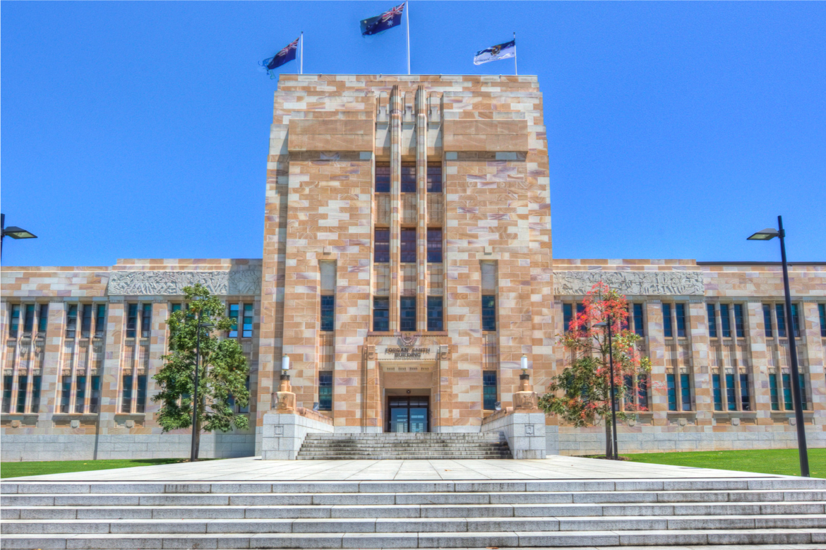
Case Study The University of Queensland’s Mental Health Strategy
Andrea Strachan
Director, Student Services &
Mental Health Strategy Implementation Board

Slide 2
The University of Queensland
Established in 1909
3 campuses
6 Faculties/4 Institutes
53,600 FTE students
18,600 postgraduate students
18,000 international students
17,000 staff

Slide 3
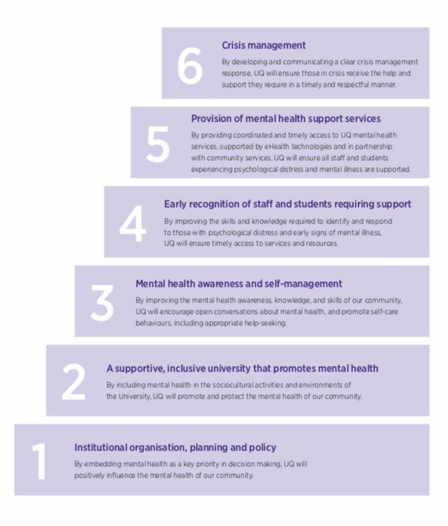
UQ Mental Health Strategy
By taking a whole of University approach, UQ set out to prioritise the mental health and wellbeing of the whole University community.
Uses a Stepped Care Approach
Strengths-Based

Slide 4
Mental Health Champions Network
Mental Health Champions Network launched in June 2019
- 97 MH Champions on board (51% Staff)
569 students and staff trained in MHFA or Supporting Students with MH Conditions.
(800 + from 2013-19 and 400+ students planned for 2020)
Mental Health Symposium in October 2019
- 284 attendees (33% students)
www.uq.edu.au/mental-health
Notes:
UQ Mental Health Website launched February 2019
4000+ total page views
Mental Health Champions Network launched in June 2019:
Mental Health First Aid (MHFA) training
The University has provided MHFA training to all staff since 2013. To date over 800 staff have been trained in MHFA. Additionally, MHFA training is also provided to students, particularly those students with responsibilities within residential halls and students holding elected positions within the Student Union.

